Slide 1




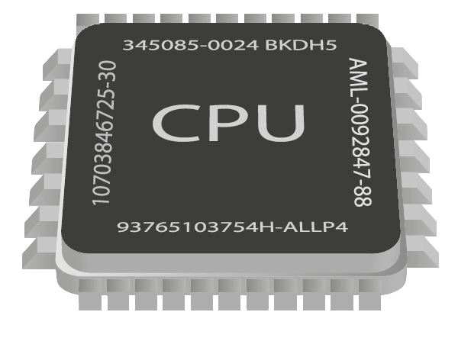
Asynchronous Programming
Writing Asynchronous Code in Java
Java
Advanced
SoftUni Team
Technical Trainers
Software University
http://softuni.bg

Slide 2

Table of Contents
Multi-Tasking
Synchronous Programming
Asynchronous Programming
Threads in Java
Concurrent classes in Java
Benefits and Drawbacks

Slide 3
Questions
sli.do #9956

Slide 4
Multi-Tasking
A computer can run many processes (applications) at once
But its CPU can only execute one instruction at a time
Parellelism is achieved by the operating system's scheduler
Grants each thread a small interval of time to run
program.exe
chrome.exe
skype.exe
system.exe
program.exe
...
0 5 10 15 20 25 ms
Notes:
What is Multi-Tasking?
How do single core single CPU computers achieve Multi-Tasking?
What is a process?
What is a thread?
How threads wait in priority queues for processor resources (time, memory)?

Slide 5

Synchronous Programming
Notes:
Executing program components sequentially
i.e. "Sequential programming"
Actions happen one after another
Uses a single thread of a single process
Components wait for previous components to finish
Program resources are accessible at all points

Slide 6
Synchronous Code
Synchronous code is executed step by step
int n = 10
printNumbersInRange()
System.out.println()
...

Slide 7
Synchronous Programming Drawbacks
If one component is blocked, the entire program is blocked
UI may become unresponsive
No utilization of multi-core systems
CPU-demanding tasks delay execution of all other tasks
Accessing resources blocks entire program
Notes:
Especially problematic with web resources

Slide 8

Synchronous Code
Live Demo

Slide 9
Asynchronous Code
Asynchronous programming allows the execution of code in the background
Does not block the main thread
int n = 10000
System.out.println()
for (0..n)
join()

Slide 10
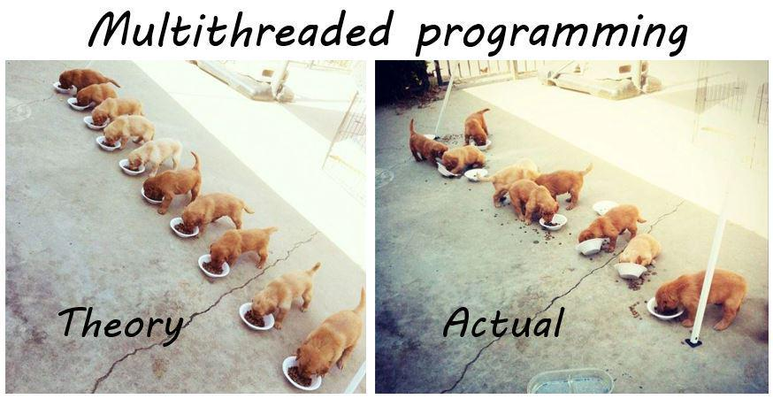
Threads

Slide 11

Threads
A thread is a fundamental unit of code execution
Commonly, programs use more than one thread
Each thread has a memory area associated with it known as a stack
Stores local variables
Stores the currently invoked methods in order of invocation

Slide 12
Threads in Java
Threads in Java can be created using the java.lang.Thread class
Constructor accepts an implementation of the functional interface java.lang.Runnable to execute on a separate thread
Thread thread = new Thread(() -> {
for (int i = 0; i < 10; i++) {
System.out.println(i);
}
});
thread.start();

Slide 13
java.lang.Thread
start() – schedules the thread for execution
join() – waits for the thread to finish its work (blocks the calling thread)
interrupt() – notifies the thread to interrupt its execution
others…

Slide 14

Threads
Live Demo

Slide 15
Thread Stack
Each thread has its own stack
The start (bottom) of the stack is the method from which the thread began execution
Each method (frame) stores local variables
...
isPrime()
printAllPrimes()
main()
...
isValidUrl
downloadAsync
background thread
main thread

Slide 16

Threads
Exercises in Class

Slide 17

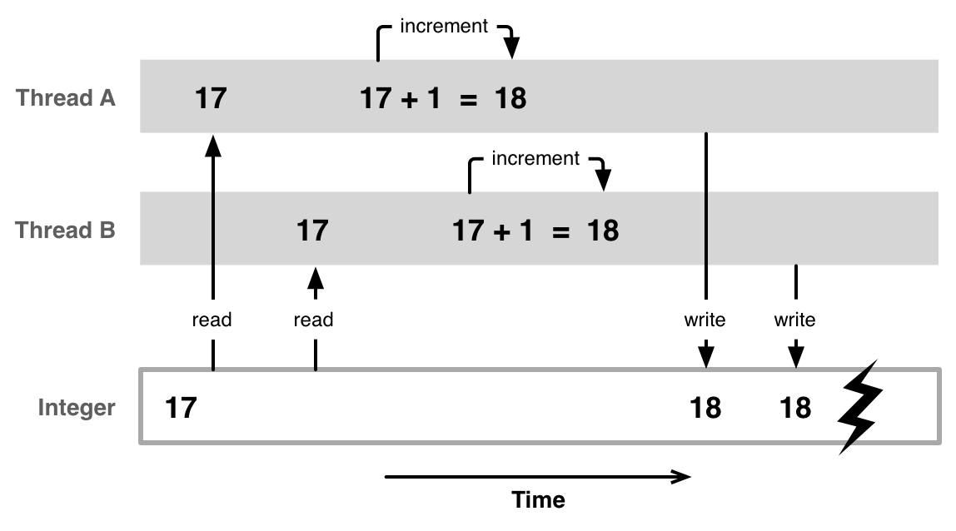
Thread Race Conditions
A race condition occurs when two or more threads access shared data and they try to change it at the same time

Slide 18

Thread Safety - synchronized
A thread-safe resource can be safely accessed by multiple threads
synchronized keyword grants access to only one thread at a time and avoids race conditions
Blocks any other threads until the resource is released
synchronized (numbers) {
// unsafe code over numbers here // ...
}

Slide 19
Thread Safety - locks
Another way to achieve this is trough an implementation of the java.util.concurrent.Lock interface
the lock must be static, so that each thread doesn’t create its own lock
what are the benefits of locks over synchronized ?
lock.lock();
// unsafe code here
// ...
lock.unlock();

Slide 20
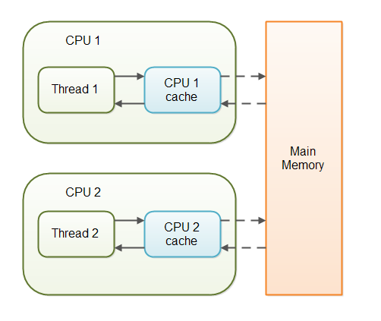
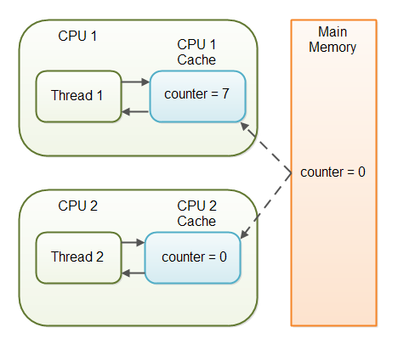
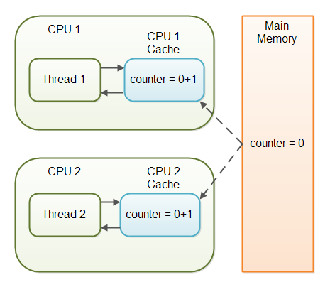
Thread Safety - volatile
volatile objects are kept in a common memory for all threads
guarantees visibility and NOT atomicity
volatile is NOT a substitute for synchronization

Slide 21

Thread safety
Live Demo

Slide 22
Concurrent classes
The java.util.concurrent package contains useful classes that can be used safely on multiple threads
Most notably concurrent collections such as:
ConcurrentLinkedQueue
ConcurrentLinkedDeque
ConcurrentHashMap

Slide 23
Legacy concurrent classes
Notable concurrent collections which aren’t in the package are:
StringBuffer - it is a thread safe StringBuilder
Hashtable - it is a thread safe HashMap

Slide 24

Concurrent classes
Live Demo

Slide 25
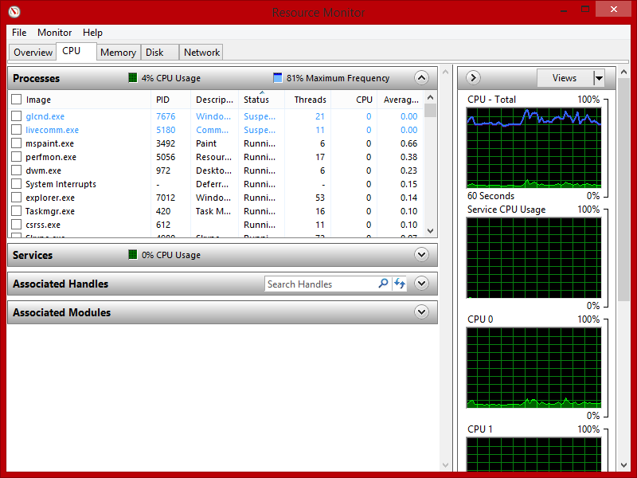
Asynchronous Programming – Benefits
If a component is blocked, other components still run
UI runs separately and always remains responsive
Utilization of multi-core systems
Each core executes one or more threads
CPU-demanding tasks run on "background" threads
Resource access runs on "background" threads

Slide 26
Asynchronous Programming – Drawbacks
Hard to know which code parts are running at a specific time
Harder than usual to debug
Have to protect resources
One thread uses a resource
Other threads must wait for the resource
Hard to synchronize resource access
Deadlocks can occur

Slide 27

Helpful Resources
Jakob Jenkov article on Java Concurrency with tutorials
Article on multithreading (computer architecture)
Article on multithreading (software)
http://tutorials.jenkov.com/java-concurrency/index.html
https://en.wikipedia.org/wiki/Multithreading_(computer_architecture)
https://en.wikipedia.org/wiki/Thread_(computing)

Slide 28

Summary
A thread is a unit of code execution
Each thread has its own call stack
Multithreading means a program can do several
operations in parallel by using many threads
Used to offload CPU-demanding work so the main thread does not block
Can lead to synchronization issues and unexpected results
Java has many useful tools for asynchronous programming
synchronized keyword
java.util.concurrent

Slide 29









Asynchronous Programming
https://softuni.bg/courses/java-fundamentals

Slide 30

License
This course (slides, examples, demos, videos, homework, etc.) is licensed under the "Creative Commons Attribution-NonCommercial-ShareAlike 4.0 International" license
Attribution: this work may contain portions from
"C# Fundamentals – Part 2" course by Telerik Academy under CC-BY-NC-SA license

Slide 31






Free Trainings @ Software University
Software University Foundation – softuni.org
Software University – High-Quality Education, Profession and Job for Software Developers
softuni.bg
Software University @ Facebook
facebook.com/SoftwareUniversity
Software University @ YouTube
youtube.com/SoftwareUniversity
Software University Forums – forum.softuni.bg

